Slide 1
Welcome to the Information Security Officer’s Advisory Group
(ISOAG) meeting
Oct. 7, 2026

Slide 2
Agenda
Agenda item | Presenter
Welcome/opening remarks | Trey Stevens, VITA
IT security governance and compliance | Amy Braden, VITA
Security architecture | Chandos Carrow, VITA
Centralized IT security audit service | Molly Castle, VITA
Risk management update | Matthew Steinbach, VITA
Threat management | Scott Brinkley and Kathy Bortle, VITA
Security products and services team | Uma Seshakrishnan and Matthew Umphlet, VITA
VITA COV Ramp team | Debi Smith, VITA
IS education and relationship management | Kendra Burgess, VITA

Slide 3
IT security governance and compliance/ISO services
Amy Braden
Director IT Security Governance and Compliance
Oct. 7, 2026

Slide 4
Overview
2026 and 2027 IT security governance and compliance
Security Awareness Training (SAT) updates
ISO services planning with key notes

Slide 5
Governance: policies, standards and guidelines, frameworks, and programs
Security standards for your review this fall:
  SEC520 – ORCA October
  SEC530 – ORCA mid-October (change notes in next slide)
  Compliance effective 2027, specific effective dates TBD
Artificial Intelligence: Key controls and resources to monitor and leverage
  Data security, inventory and classification
  Third party risk management – contracts/assessments
  Acceptable Use Policy updates as applicable
  Commonwealth AI registry
  Expect more of this in 2027 and as industry/legislation matures
Our GRC platform update expected to continue into 2027. Ideally this drives process and data improvements as part of reducing labor and increasing knowledge sharing. 2027 compliance impact TBD. Please monitor the project and 2027 impacts.

Slide 6
SEC 530 objectives and implications
Objectives:
Align with latest National Institute of Standards and Technology version
Reduce COV controls
Reduce common security exceptions
Align with technical capabilities and architecture standards
Implications:
Small backlog of updates expect in 2027 as technical controls mature with new/updated security services
Enforcement of some controls to flex given availability of solutions, particularly enterprise services/technology

Slide 7
2026 IT audit compliance
Audit metrics calculated using data as of Dec. 31, 2026
IT audit plan
IT audits for sensitive systems
Quarterly updates for findings

Slide 8
2026 IT risk compliance
Risk metrics using data as of Dec. 31, 2026
Applications certified
BIA
IT risk Assessment plan
IT risk assessments for sensitive systems
Quarterly updates for any open findings
Self assessment completed – requires full completion: pass/fail
ISO reports to the agency head
ISO certification

Slide 9
2026 InfoSec program compliance
Metrics monitored and reported in the annual report, but not part of the included in overall grade and annual IT strategic plans (ITSP)
Current SAT campaign and plan (due no later than Jan. 29, 2027)
  30-day lag to any programs that run in December and new hires
Approved and current security exceptions

Slide 10
Third-party compliance
Vendor SOC 1s delivered in September. New reports available for reviews.
  Please coordinate reviews with governance.
Vendor SOC 2s are due Nov. 1 and will be available for review.
Other teams supporting SOC reviews:
  MSI audit/compliance*
  COV Ramp
*Supplier information available to ISOs on CENTER. Confirm access/contact MSI with any questions. ISOs should be able to same/agency specific information.

Slide 11
Security Awareness Training (SAT)
Role-based training
  Release in Q4
SAT campaign has been launched
  Be sure to complete your organization SAT no later than Dec. 31, 2026.
Governance has reviewed and identified KB4 modules relevant to AI
  If haven’t received, expect that list to drop

Slide 12
2026-2028 Centralized ISO Security Services (CISS)
New MOUs disseminated for renewals, requested response in September.
If opted out, be sure to officially update IT risk plans and ISO services flag in Archer.
  Please work with governance analyst to ensure Archer updates for these items align.
Goal is to send FY2027 invoices late Q4/early next quarter.
  Fiscal year* activity does not always align with calendar year and/or note that VITA finance labels on the invoice.
  If there are billing questions, please contact me or Mike Vannoy.
2027 IT audit/risk plans (opt-in/out form) are no later July 1, 2027 to accommodate Q1/Q2 budget planning compared to FY2028 activity.
  Please work with finance, VITA and DBP for any budget adjustments desired (ITSP process).
*Note fiscal year: July 1- June 30

Slide 13
Security architecture
Chandos Carrow
Oct. 7, 2026

Slide 14
Security architecture (SA) 2026 metrics
Over 180 architecture overview documentation reviews
Over 300 security baselines reviewed
Over 440 security exceptions assessed
Roughly 30 System Security Plans evaluated
Over 180 Request Item/INC tickets assessed
Over 380 Request For Solution DMND requests reviewed

Slide 15
SA 2026 accomplishments
Reoccurring information security requirements for SEC530
  Document that identifies all events in SEC530 that have a reoccurring frequency
  Created document, but needs to be published
Updated SSP templates
  Available on the VITA website
Port baseline
  Identification of the accepted and unaccepted communications ports between the zones of the zero trust model
  Created document and is being used in the firewall rule requests review process
Entra ID process documentation
  Framework establishing how the various software as a services throughout the Commonwealth shall connect for identification and authorization purposes to the COV Entra ID
  Created documentation for process flow
  Updated Keystone Edge (KSE) knowledge base article (KBA)
Enterprise SSP evaluation instructions
  Instructions for both suppliers and the evaluation team on how the SSP evaluation process operates and what goes into the creation of a SSP
  Created document and shared it with suppliers

Slide 16
SA 2027 goals
Roles and responsibilities matrix for SEC530
  Suggested distribution of responsibilities to roles for all controls and sub-controls within SEC530
  Matrix has been filled out, but needs to be reviewed and assessed before publishing
Entra ID process documentation
  Framework establishing how the various software as a services throughout the Commonwealth shall connect for identification and authorization purposes to the COV Entra ID
  Working on putting application registration into Archer
  Working on recertification process
Control assessment forms
  Forms to assist those with being compliant to CA-2
Baseline instructions
  Instructions for both suppliers and the Baseline Steering Committee on how the baseline process operates and what goes into a baseline
Security exceptions FAQ
  Develop a FAQ for security exceptions to streamline the process, minimize unnecessary requests and reduce back‑and‑forth with agencies

Slide 17
Centralized IT security audit service
Mark McCreary, CISA®, CISSP®, CISM®
Director
Molly Castle, CIA®, CISA®, CISSP®
Manager
Oct. 7, 2026

Slide 18
Security controls (1 of 2)
Some obvious controls can be ignored!
Oct. 19, 2025 heist at the Louvre Museum in Paris.
Notes:
Heist occurred on October 19, 2025, so almost a year ago.

Slide 19
Security controls (2 of 2)
When controls are ignored, bad things can happen.
Like walking away with $102 million in jewels.
Notes:
It took all of 7 minutes for the robbers to get away with the jewelry.

Slide 20
Top 10 countdown of audit issues

Slide 21
Number 10 of top audit issues
10. Not documenting how the impacts resulting from a compromise of data confidentiality, integrity or availability were determined
Notes:
Requirement 4.2 under IT System and Data Sensitivity Classification.

Slide 22
Number 9 of top audit issues
9. Limited review and analysis of audit logs
Notes:
AU-6 Audit Record Review, Analysis, and Reporting. At least every 30 days.

Slide 23
Number 8 of top audit issues
  8. Not disabling inactive application accounts, especially for web-based applications
Not disabling accounts within 24-hours of a user’s employment terminating
Not disabling user accounts after 90 days of inactivity
Notes:
PS-4 Personnel Termination-24 hours and AC-2-CE (3) 90 days of inactivity.

Slide 24
Number 7 of top audit issues
  7. Not using two-factor authentication
    When accessing sensitive systems over the internet
    When accessing development environments or using privileged accounts
Notes:
IA-2 (1) MFA for privileged accounts and AC-17-COV-g Ensure that remote sessions for accessing sensitive data or development environments employ two-factor authentication.

Slide 25
Number 6 of top audit issues
  6. Prohibit granting local administrator rights to users
Agency heads not approving exceptions to this requirement for those employees whose documented job duties are primarily the development and/or support of IT applications and infrastructure
Not documenting exception approvals annually and including the agency head’s explicit acceptance of risk
Adding a regular (non-administrative) network user account to a computer’s local administrator group or other groups used to control access to restricted security functions
Notes:
AC-2-COV a.8 Account Management

Slide 26
Number 5 of top audit issues
5. System security plans do not accurately depict “existing” vs. “planned” controls and/or align with security standards
Notes:
PL-2 System Security and Privacy Plans

Slide 27
Number 4 of top audit issues
4. Risk assessments/risk assessment reports
Not conducting risk assessments that identify and evaluate threats, vulnerabilities, likelihood of occurrence and magnitude of impact
Not documenting risk assessment results in a risk assessment report containing an executive summary that includes major findings and recommendations along with an identification of all vulnerabilities discovered during the assessment
No evidence of agency head review and approval
Not current
Notes:
RA-3 Risk Assessment

Slide 28
Number 3 of top audit issues
3. Not remediating legitimate (not false-positive) vulnerabilities withing required timeframe
Critical, high = 30 days
Others = 90 days
Notes:
RA-5-d Vulnerability Monitoring and Scanning

Slide 29
Number 2 of top audit issues
2. The ISO does not report directly to the agency head and/or is not independent from IT
Notes:
2.4 Agency Head Roles and Responsibilities

Slide 30
Number 1 of top audit issues
1. Not submitting security exception requests when controls are not implemented or followed
Notes:
1.5 Exception to Security Requirements

Slide 31
Bonus top audit issue
The ISO is not a member of a Change Control Board and/or there is no evidence the ISO reviews proposed configuration-controlled changes to systems and approves/ disapproves such changes with explicit consideration for security and privacy impact analyses
Notes:
1.5 Exception to Security Requirements

Slide 32
What can you do?
Contact CSRM!
Become familiar with security standards. If you have a question about a control, the governance team can provide clarification or an interpretation.
Architects can help with security exceptions and identifying mitigating controls.
Work with governance to close findings when corrective actions are complete.
Provide quarterly finding updates to CSRM to maximize that component of the annual audit score.

Slide 33
Questions?
Mark McCreary
Molly Castle
Mark.McCreary@vita.virginia.gov
Molly.Castle1@vita.virginia.gov

Slide 34
Risk management update
Matt Steinbach
Oct. 7, 2026

Slide 35

SEC520 updates
Added
Updated
Removed
Risk Register
Required when performing risk assessments
Risk treatment plan
Now the output of the risk assessment, replacing the corrective action plan
530 control analysis
No longer required to analyze ALL 530 controls as part of the risk assessment process
SSP updates
No longer required to document/update the SSP based on risk assessment results
Vulnerability management
Can’t meet the defined timeframe? Submit a corrective action plan to the CISO via the exception process
IDS section
Removed from the standard
Notes:
SEC520 is currently in Orca for review and comment
Proposed SEC520 changes:
Added language to require the use of the Risk Register when performing risk assessments.
Removed language that required analysis of all 530 controls when performing risk assessments.
Updated language so that the output of the risk assessment yields a risk treatment plan instead of corrective action plan.
Removed the requirement to document and/or update the System Security Plan based on Risk Assessment results.
Updated language in the vulnerability management section: for vulnerabilities that cannot be addressed within the defined timeframe, submit documented corrective action plans to the CISO using the Exception Process.
Removed the IDS section.
We'll be looking at additional changes to 520 that will help support risk assessment activities using the risk register in 2027

Slide 36
Risk Register: goal and purpose
Standardize agency-level risk assessments
Enhance enterprise-wide reporting
Shift focus beyond compliance
Focus on the risks CSRM has identified as important
and roll up system-level risk for reporting at every level.
System
Agency
Secretariat
Enterprise
Find the Risk Register: Archer | VITA website
Notes:
Goal and Purpose:
Establish a standardized approach to agency-level risk assessments, enhance enterprise-wide reporting, and shift focus beyond compliance.
This standardization will help agencies focus on risks CSRM has identified as important and enable CSRM and agencies to summarize system level risk to facilitate agency, secretariat, and enterprise level reporting.
The Risk Register can be found in Archer and on the VITA website: https://www.vita.virginia.gov/media/vitavirginiagov/it-governance/psgs/docs/COV-Risk-Register-.xlsx

Slide 37
Risk Register: risk findings
Tie to the Register
Each finding ties directly to the Risk Register item(s) it associates to
Document gaps
Control gaps elevating risk are documented
in the finding’s
mitigation plan
Quarterly updates
Show mitigation reducing risk to an acceptable level
1
2
3
Control gaps not expected to be remediated within 90 days require an exception.
90
Days
Notes:
Risk Findings:
Risk Findings will tie directly to the risk register item(s) they associate to.
Risk findings will function the same way, quarterly updates required, showing mitigation to reduce the risk to an acceptable level.
If specific control gaps are identified as elevating risk, those controls will be documented in the risk finding mitigation plan. If the control gaps are not expected to be remediated within 90 days an exception will be required.

Slide 38
2027 risk management initiatives
Improved risk reporting and metrics in Archer
Risk dashboard
Supplier and enterprise application risk
Better visibility
Connected metrics
Compliance, vulnerabilities, incidents, and more
Notes:
2027 Risk Management Initiatives:
Improved risk reporting and metrics in Archer:
- Risk Dashboard
- Better visibility into supplier risk and enterprise application risk
- Connections to metrics such as compliance, vulnerabilities, incidents, etc.
-Contingent on good data in Archer and performing risk assessments with the risk register

Slide 39
Business interruption risk: MSI-identified gap
Agency-defined
recovery objectives
Subscribed
disaster recovery tier
Risk
Recovery objectives may not be met
CSRM response: Creating an Archer reference field that shows the DR tier each application subscribes to
Your action: Keep your application inventory up to date and accurate
Business processes
Recovery objectives
Associated devices
Associated products and services
Notes:
Business Interruption Risk:
MSI has identified potential gaps in recovery objectives defined by agencies and the DR tiers that they subscribe to.
These discrepancies could result in recovery objectives not being met.
In an effort to reduce this risk, CSRM is working to create a reference field in Archer that shows the DR tier subscribed to by that application.
Please ensure your application inventory is up to date and accurate, including business processes, recovery objectives, associated devices, associated products and services.

Slide 40
2026 cybersecurity self-assessment (formerly NCSR)
Now live
in Archer
Agency ISOs can complete the 2026 cybersecurity self-assessment now
Self-assessment — accuracy matters
Please ensure your responses are accurate
CSRM uses your information to inform
risk and governance of potential issues and gaps in maturity
Notes:
The 2026 NCSR is live in Archer and can now be completed by agency ISOs.
The NCSR is a self assessment, but please ensure responses are accurate. We are utilizing your information to help inform risk and governance of potential issues and gaps in maturity.

Slide 41
2026 cyber liability insurance umbrella policy
Graphic redacted for security reasons
Notes:
The retention went from $1.5 million per occurrence to $1 million per occurrence from last year to this year. Retention is the amount the insured must pay before the policy kicks in.
The premium went from $1,192,953.00 down to $1,059,825 from last year to this year.

Slide 42
Contact VITA
Jonathan Smith
CSRM risk manager director
jonathan.m.smith@vita.virginia.gov
Matt Steinbach
CSRM risk management manager
matthew.steinbach@vita.virginia.gov
Risk analysts by secretariat
Andrew Wirz
Andrew.Wirz
@vita.virginia.gov
Isaac Amoani
Isaac.Amoani
@vita.virginia.gov
John Willinger
John.Willinger
@vita.virginia.gov
Marjean Adarkwa
Marjean.Adarkwa
@vita.virginia.gov
Commerce and Trade
Agriculture and Forestry
Administration
Executive
Authority
Health and Human Resources
Finance
Education
Public Safety
Independents
Labor
Transportation
Security
Natural Resources
Notes:
Contacting Us:
Jonathan Smith, CSRM Risk Manager Director - jonathan.m.smith@vita.virginia.gov
Matt Steinbach, CSRM Risk Management Manager - matthew.steinbach@vita.virginia.gov
Risk Analysts by Secretariat:
Andrew Wirz - Commerce and Trade, Finance, Independents, Security
Isaac Amoani - Agriculture & Forestry, Education, Labor, Natural Resources
John Willinger - Administration, Authority, Public Safety, Transportation
Marjean Adarkwa - Executive, Health and Human Resources

Slide 43
15 Minute Break

Slide 44
Threat management directorate
Oct. 7, 2026

Slide 45

Threat management directorate introduction
Dean Johnson
Director
Dean.Johnson@vita.virginia.gov
Kathy Bortle
Threat intel and vulnerability management manager
Kathy.Bortle@vita.virginia.gov
Scott Brinkley
Incident response manager
Scott.Brinkley@vita.virginia.gov

Slide 46
Threat management directorate responsibilities
The VITA CSRM threat management directorate has the following responsibilities:
  Incident response
  Digital forensics
  Threat intelligence
  Vulnerability management

Slide 47
Digital forensics and incident response

Slide 48
2026 accomplishments
What have we done for you lately?
Incident response
Digital forensics
Security engineering
Expansion of team
Team starting to assume lead in more incidents
COV internal sandbox
MS-ISAC
Expansion of team and team Knowledge
More mobile device capabilities. We can capture a device with the same tools as law enforcement other than password cracking.
Splunk ingest fixes
Changes being made in the environment for better alerting
Notes:
Speak on difference between contract-only SOC and centralized escalation
nebulous nature of escalation

Slide 49

More to come …
2027 planning
Integrating with the CSRA (GDIT) SOC and Sec Ops
Formal escalation point for incidents
Expand/enhance information available in agency dashboards in Splunk
Integrating AI into response playbooks and forensics
COV tabletop exercise changes (evolving tabletop)

Slide 50

COV TTX 2026
Commonwealth of Virginia tabletop exercise
How will VITA CSRM and SOC respond?
Schedule
  Oct 21 from 10 a.m.-4 p.m. – Exercise
  Oct 22 from 11 a.m.-12 p.m. – After-action
Please sign up to participate
  MSI Security Operations (MSI-SIRT)
  msi-security-operations@saic.com
Number of injects: ~16
RSVP by Friday, Oct. 9

Slide 51

COV TTX 2027 (1 of 3)
January
Rollout injects bimonthly
Debating response to each inject or response at the end in October

Slide 52
COV TTX 2027 (2 of 3)
March
July
Inject 2 – Tailored to news or current projects
Inject 4 – Tailored for currency
May
September
Inject 3 – Tailored for currency
Inject 5 – Beginning of narrative event

Slide 53
COV TTX 2027 (3 of 3)
Feedback
Please share comments with
VITA IR Manager Scott Brinkley
scott.brinkley@vita.virginia.gov
October
Narrative event
Separate injects for more nuance agency relevance
End of tabletop

Slide 54
Threat intelligence and vulnerability management

Slide 55
2026 vulnerability management accomplishments
Enterprise Software Supported Products (ESSP) list was updated after two years and is now being updated regularly as changes occur
Refined Nucleus assignment rules to reflect vulnerability ownership according to the ESSP.
  Rules are updated each time the ESSP is changed.
Achieved Tenable changes to suppress “Superseded” patches.
Nucleus ticketing: implemented Service Now ticketing for all agencies. ISOs should not need to open tickets for patching service provider responsibilities.
In preparation for CSRA (GDIT) Tenable SC to Tenable One transition, worked with Unisys on updating infrastructure settings for DNS/DHCP to try and provide more accurate device identification.

Slide 56
2026 threat intelligence accomplishments
One full-time employee (Jared Karnes) now devoted to standing up our threat intelligence program
Evaluated and selected a new threat intelligence platform
Evaluated and selected a new web application scanning platform
Hired four new professionals on the web app scanning (1) and vulnerability management (3) team

Slide 57
2027 planning improvements
Web application scanning
  Clean up retired URLs before migration to the new platform
  Migrate Acunetix 360 to the new platform following COV Ramp approval
  Migrate web application scanning from a monthly to a weekly cycle once on the new platform
Vulnerability management
  Continue to clean up Tenable data in preparation for migration to Tenable One
  Prepare Nucleus to accept Tenable One data
  Pilot integration of CNAPP data into Nucleus
Threat intelligence
  Develop COV-specific threat intelligence advisories as data is received from the new threat intel platform and third-party providers
  Formalize a plan to collect and share COV threat indicators with other agencies and public bodies

Slide 58
Questions?
Thank you for attending
Contact threat management at threat.management@vita.virginia.gov

Slide 59
Security products and services (SPAS) team
Onboard, enable, evolve
Uma Seshakrishnan
Oct. 7, 2026

Slide 60


What we do
Onboard new products and manage them through their full lifecycle
What that means for you
User guides
Step-by-step help, whenever you need it
Training videos
Learn at your own pace, on demand
Lunch-and-learns
Have lunch and learn new skills
Office hours
Drop in with questions, get live answers and product updates

Slide 61

Learn with us live!
Hands-on workshops
SPAS office hours
3
Hands-on workshops happening every other month since April
1st
Wednesday of every month
2–3 p.m.
2 × Splunk workshops
1 × Archer workshop
Running monthly since May

Slide 62
Save the date: yearly event
NOVEMBER
The Security Products Fair is here!
Key customer engagement event
Will be held every year
This is the very first one
Come meet the people behind the tools
17
Tuesday · 2026
6 vendors
Sharing their latest product updates
Live Q&A
Bring your questions, get answers on the spot
Leadership
CSRM leadership in the conversation

Slide 63
Save your seat in three easy steps
1
Watch your inbox
2
3
Join office hours
Register
Look out for the email from VITA Comms with all the details.
Sign up for workshops using the registration form.
Use the SPAS event link on VITA Connections to attend office hours.

Slide 64
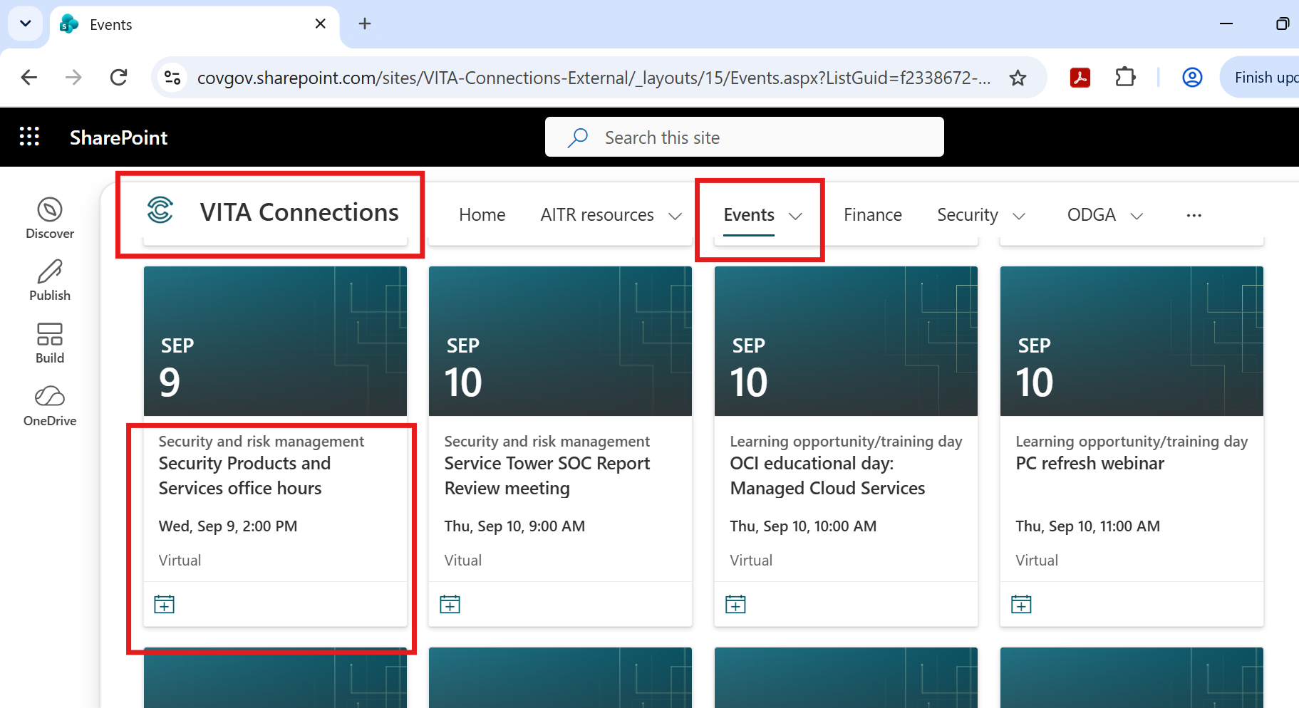
Where to find SPAS office hours event link?

Slide 65
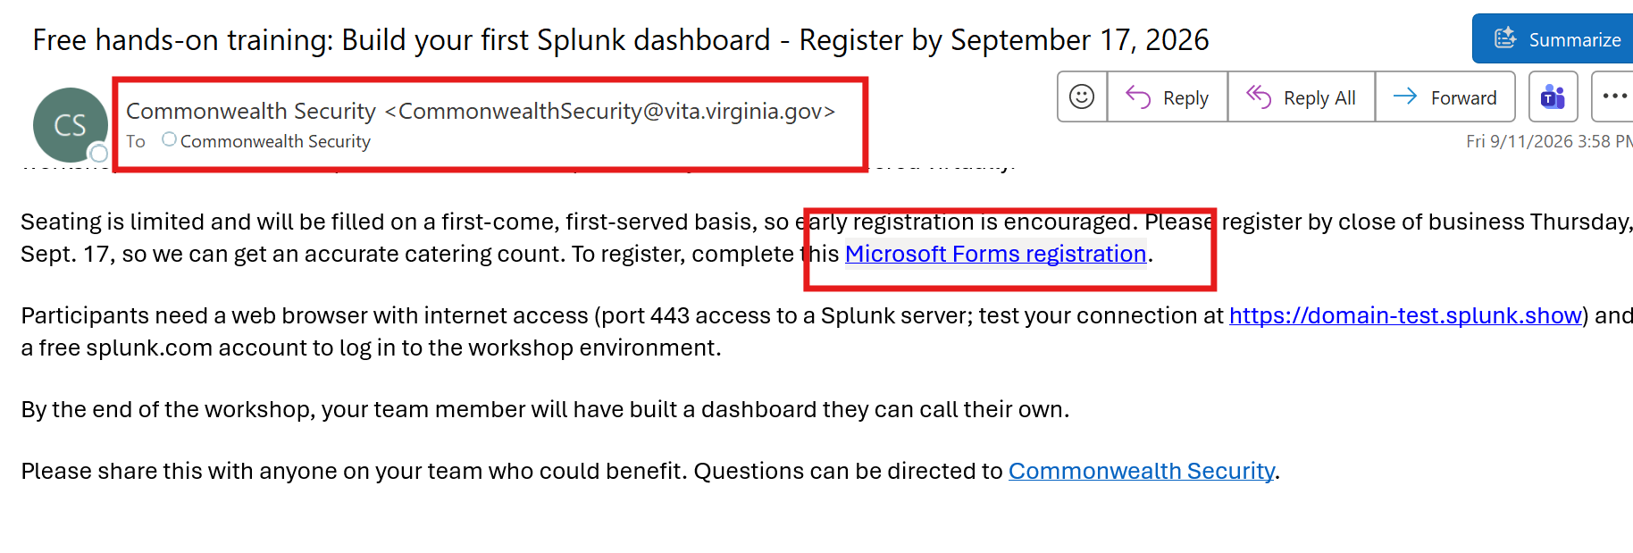
How do I register for SPAS workshops?

Slide 66
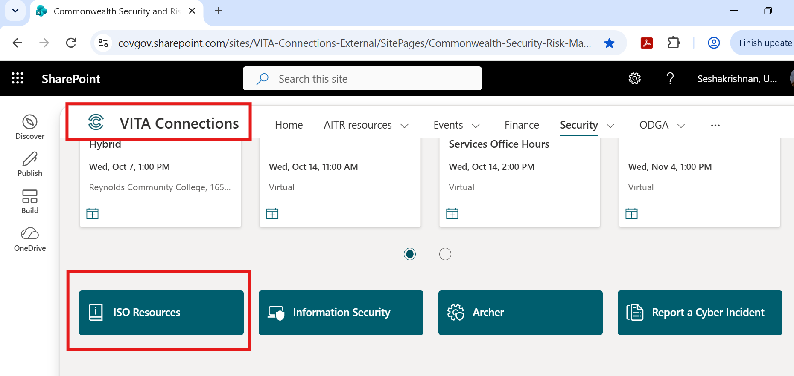
How do I find resources?

Slide 67
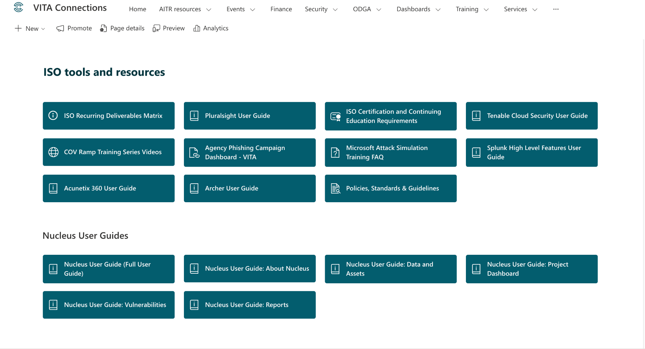
Where are the user guides and training videos?
VITA Connections > Security > ISO Resources

Slide 68

On the roadmap: GRC is next up
Beyond the internal tools we’ve already onboarded, our big focus right now is a GRC platform.
Underway
Production evaluation
Now
Round two evaluation
This month
Recommendation to CSRM leadership team
Top two finalists
Coming up: SAT and phishing
Archer Cloud verses Diligent
Big thanks to our internal and external stakeholders, especially TAX and DOE!
Revisiting old requirements and filling gaps. More updates in the coming months.

Slide 69






We’re picking a name, not flipping a switch
What "identifying a product" means
Archer Cloud or Diligent: that’s the decision on the table. Nothing changes in your day-to-day yet.
Name chosen
Early adopters
Phase 1: internal
Phase 2: external
Recommended to CSRM execs
A pilot group test drives it first
Rolled out to
internal users
Extended to
external users
Training all along the way: multiple rounds, multiple levels, from first look to power user

Slide 70
Questions?
Reach out anytime for information about workshops, office hours,
GRC or what’s next.
Uma.Seshakrishnan@vita.virginia.gov
Thank you!

Slide 71
Upcoming tool:
Axonius
Matthew Umphlet
Security Solutions Manager
Oct. 7, 2026

Slide 72
What is cybersecurity asset management?
Key functions
It establishes visibility across hardware, software, cloud resources and — where in scope — OT systems, identities and sensitive data stores.
It exposes shadow IT, unauthorized services and unmanaged assets that may lack patching, monitoring or policy coverage.
Asset context (ownership, criticality, exposure, configuration) enables risk-based remediation and more efficient security investment.
A current inventory:
  Reduces attack surface, speeds incident scoping and recovery
  Underpins vulnerability management, zero trust and audit readiness

Slide 73

Axonius: cybersecurity asset management platform
Axonius provides cybersecurity asset management through adapter connections to existing systems

Slide 74
What is an Axonius adapter?
Axonius adapters are not another agent!
An Axonius adapter is an API integration that the Axonius platform can use to fetch important information about devices and users from tools that are already in the COV environment
Adapters can pull:
  Device serial number
  Installed software
  Configuration Management Database data
  Device owner
  And more!
There is no limit to the number of adapters that can be connected

Slide 75





What is connected today?
And more!

Slide 76
How is data separated?
Agencies are only allowed to see agency data
Data is separated by a key field
  We are currently basing this on the "assigned to company" field from CMDB

Slide 77
Query wizard: no-code search across every adapter
What it is: a visual, no-code query builder
  You pick fields from any connected adapter and combine them
  no scripting required
Boolean logic model, stated plainly:
  AND — narrow results (must match all conditions)
  OR — broaden results (match any condition)
  NOT — exclude a condition (this is the one that finds gaps, and gaps are where most findings live)
Conditions can be nested/grouped, and conditions can pull from different adapters in the same single query
Queries can be saved for quick reference later or be used to build dashboards

Slide 78
Dashboards
Dashboards are created from saved queries
Fully customizable
Widgets and charts
  Pivot chart
  Query intersection
  Field summary
  And more!
Drill-down from any chart straight to the underlying asset list

Slide 79
COV Ramp
Debi Smith
COVRamp Security Architecture Manager
Oct. 7, 2026
Notes:
Christie

Slide 80
When is COV Ramp applicable?
80
COV Ramp applies for all procurement methods that: have a cloud component, is SaaS or involve a data share
Methods of procurement
VITA statewide contracts, specifically software VAR contracts
(i.e., POs and SOWs)
Cooperative contracts
(GSA, NASPO, etc.)
Request for proposals (RFP)/solicitations with a cloud component
Any procurement that involves a cloud component (i.e., small purchases, sole source, emergency, etc.)
Notes:
Christie

Slide 81
Components of COV Ramp
81
There are three components to be followed when procuring cloud/SaaS services
COV Ramp
security assessment
Cloud terms and conditions
COV Ramp
ongoing oversight
1
2
3
Notes:
Christie

Slide 82
High-level COV Ramp process map
Security architects
Agency submits COV Ramp with assessment
Submit via portal
SCM team
Review process starts
VITA first and second reviews
Schedule conference for completion
Submit via email
Oversight team
Approval with exceptions
(oversight process begins)
Cloud terms and conditions starts
Cloud T’s & C’s and exceptions happen in parallel
Exception process starts
Exceptions submitted
by agency
Submit via Archer
SCM engagement
with agency
Exceptions entered into Archer and reviewed
Submit via email
Cloud T’s & C’s reviewed and approved
Exceptions must be approve before contract can be signed
Exceptions reviewed
and approved
Agency contract
Oversight active
Notes:
Debi

Slide 83
Responsible parties for each component of COV Ramp
83
Who at VITA is responsible for each component of COV Ramp?
1
COV Ramp
security assessment
2
Cloud terms and conditions
3
COV Ramp ongoing oversight
Commonwealth security and risk management
Security products and services
Enterprise services
  Debi Smith
  Iris Frimpong
  Sharon Richardson
Supply chain management
Enterprise sourcing and risk management
Supply chain risk management
  Leia De La Garza
  Christina McCloud
  Sonja Headley
  Kashera Lane
  Travis Cattenhead
  Ryan Olson
Commonwealth security and risk management
Security products and services
Enterprise services
  Iris Frimpong
  Wilbert Jones
  Andre King
Notes:
Christie

Slide 84
COV Ramp EQ review process to be implemented
New stage for approvals
  Currently the assessment process begins with agency approvals
  A new approval stage is being added to assist agencies with their solutions
EA will review each submission
  EA will review each submission for an existing solution to save the agency time and money
  EA will also review each submission for any AI components
EA approval steps
  EA representative will reach out to the agency to provide information on an existing solution
  EA representative will assist, if needed, in submission for AI approval
  EA will then mark approved and move to the assessment to the assessment team

Slide 85
COV Ramp security exceptions update
SEC 530 re-reviews?
  All currently approved solutions have been updated for SEC 530
  Any existing solutions that come up for renewal will be updated as needed
Most commonly removed security exceptions
  SI-2 for patching compliance, most vendors now fall within the required timelines
  SC-12-COV for key management is no longer required and removed during the update
  Note: Please do not close without an update from the COV Ramp team
Others clean up areas
  The COV Ramp audit team is regularly reaching out to vendors for updated patching schedules
  All new approvals are being sent to the agency ISO

Slide 86
COV Ramp security exceptions update for MA-5-COV
SEC 530 review for MA-5-COV – maintenance personnel
  The COV Ramp assessment team obtains a maintenance personnel policy/procedure
  The COV Ramp team validates with the vendor notification prior to access to COV tenant
Exception requirements from the vendor
  The vendor must provide the associated policy/procedure
  The vendor must agree to notify the agency contractually via the cloud terms and conditions
Exception Requirements for the Agency
  The agency must submit the required security exception within Archer

Slide 87
COV Ramp security exceptions update for SA-9-COV
SEC 530 exception for SA-9-COV
  The agency must have an URGENT need for this security exception
Exception requirements from the agency
  The agency must have a COV Ramp assessment in progress … OR
  The agency must have an SCM task in progress for cloud terms and conditions
  The agency must also have a COV Ramp oversight RITM submission number
Criteria for exception acceptance and approval
  A valid URGENT requirement for the exception
  The RITM number for either the assessment OR the cloud terms in progress
  The RITM number for oversight submission
  Note: The exception is only good for 90 days

Slide 88
What’s new with black kite
SEC 530 compliance button
  The COV Ramp team is working with the vendor to ADD SEC 530 to Black Kite for our tenant
What will this NEW compliance button provide?
  This will allow direct mappings to all SEC 530 controls
  The control areas will also contain “–COV” specific controls
Benefits for the ISO
  A downloadable risk assessment for the specific solution
  A downloadable gap analysis for the specific solution
  Saving the ISO time in capturing areas of risk or gaps within the solution
  Assisting the ISO with submission of any required security exceptions and SSPs
  Providing a deeper dive into the solution as a whole

Slide 89
COV Ramp
Points of contact
Notes:
Christie

Slide 90
COV Ramp contacts
For all other inquiries about cloud services (COV Ramp):
Enterprise services
enterpriseservices@vita.virginia.gov
Debi Smith
COV Ramp security architect manager
Debra.Smith@vita.virginia.gov
Richard White
Director of security products and services
Richard.White@vita.virginia.gov
Iris Frimpong
COV Ramp oversight lead
Iris.Frimpong@vita.virginia.gov

Slide 91
COV Ramp Questions?

Slide 92

Announcements
ISOAG October 2026

Slide 93
Website updates
SEC527 Crosswalk update Q2
ISO Recurring Deliverables Matrix
Pluralsight User Guide
Reminder: Always access policy and governance documents directly through vita.virginia.gov.
Do not rely on saved favorites or old links!

Slide 94
Top five vulnerabilities
For the month of October, the top five key vulnerabilities are:
KB5073455: Windows 11 version 23H2 security update (January 2026)
Oracle Java SE multiple vulnerabilities (April 2025 CPU)
Google Chrome < 151.0.7922.169 multiple vulnerabilities
Microsoft .NET Core SEoL
Zoom Workplace < 6.3.10 vulnerability (ZSB-25030)

Slide 95
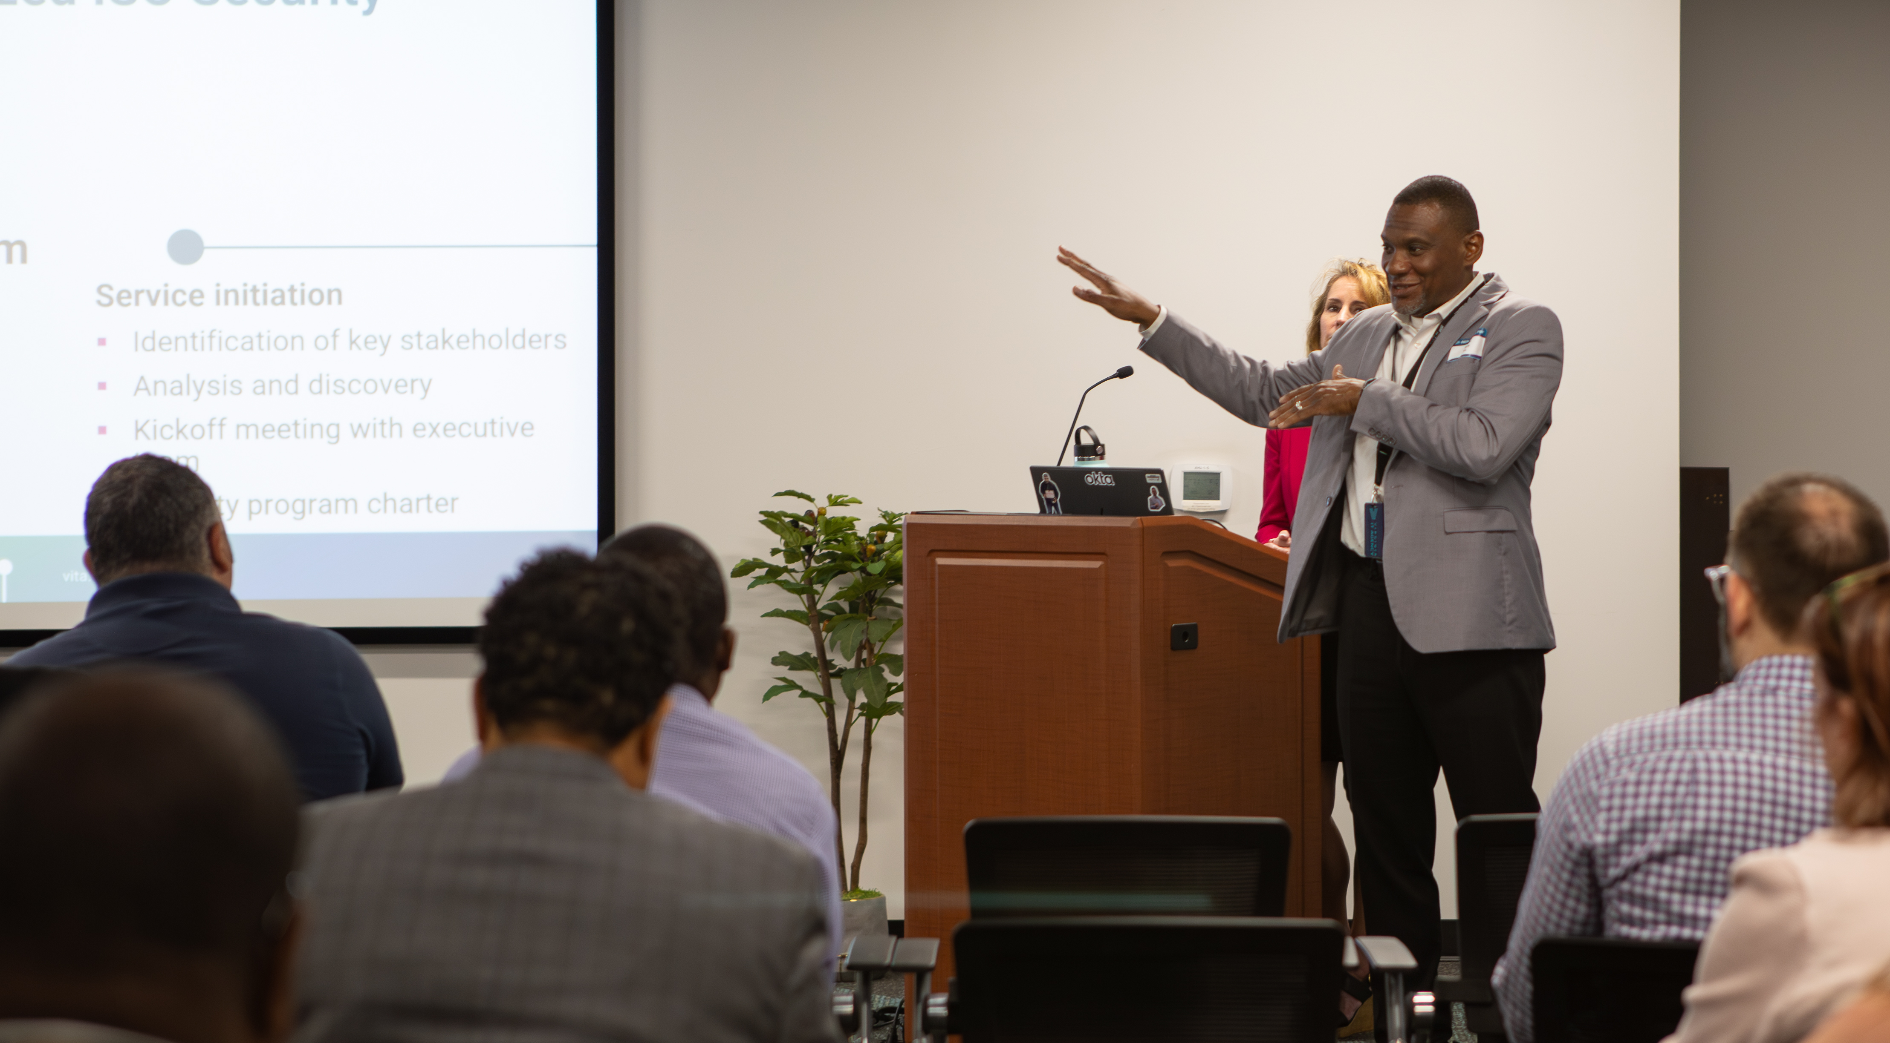
Upcoming events

Slide 96
COV TTX 2026
Commonwealth of Virginia tabletop exercise
How will VITA CSRM and SOC respond?
Schedule
  Oct 21 from 10 a.m.-4 p.m. – Exercise
  Oct 22 from 11 a.m.-12 p.m. – After-action
Please sign up to participate
  MSI Security Operations (MSI-SIRT)
  msi-security-operations@saic.com
Number of injects: ~16
RSVP by Friday, Oct. 9

Slide 97
Upcoming governance office hours
Governance office hours
  Dedicated space for agency ISOs and teams to bring their questions, concerns or ideas.
October agenda
  Q&A session (from ISO etc.)
  Audit finding updates/exceptions
Next sessions
  Oct. 14, 2026 | Microsoft Teams
    Click here to register for the meeting
  Nov. 10, 2026 | Microsoft Teams
    Click here to register for the meeting

Slide 98
Security products and services office hours
Office hours
Oct. 14
2–3 p.m.
Join link: VITA Connections/Event
Nov. 10
2– 3 p.m.
Join link: VITA Connections/Events
Sample Agenda
        Welcome and housekeeping
          Introductions, recording notice, agenda overview
        Program updates
          Latest announcements and milestones
          Update from threat management team (first session)
        Action item review
          Recap prior items, owners and status
        Open Q&A and issue review
          Live questions and issue discussion
          Follow-ups scheduled as needed
        Wrap-up and next steps
          Key takeaways and next session preview

Slide 99
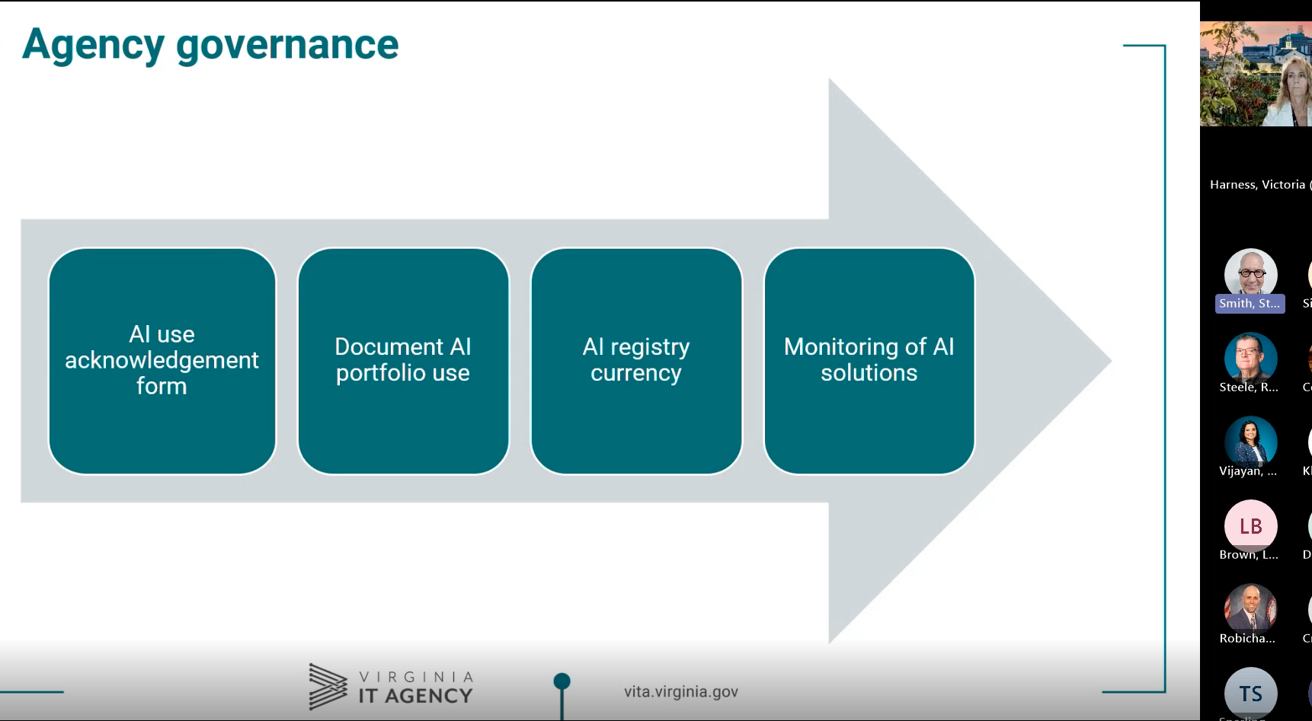
AITR meeting
Did you miss it?
Past meeting recordings, other videos and training courses are available on the VITA Connections site​
Next AITR meeting is
Wednesday, Nov. 18, at 9 a.m.
​

Slide 100
Service tower SOC report review sessions
The upcoming SOC review session is Dec. 9, 2026, and will be held remotely.​
​
To register for this meeting, please click on this link: Register via Webex​

Slide 101

ISOAG is hybrid!
We do have limited seating for in-person attendance at the upcoming ISOAGs. Please reach out if you are interested in joining us in-person!​
​
It is an excellent opportunity to meet your fellow ISOs and put faces with names. You also have the opportunity to ask questions in a more informal setting during the break. ​
Important: Primary, in-scope agency ISOs must still attend the October ISOAG meeting in person.

Slide 102
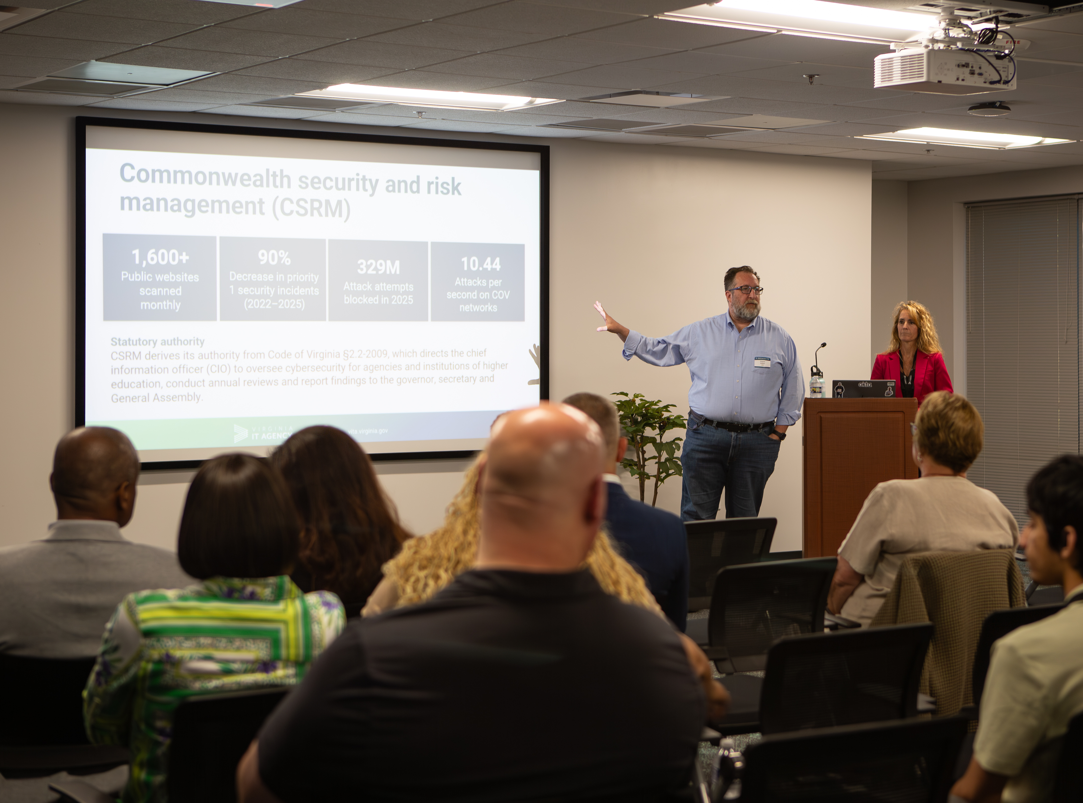
IS orientation
The next IS orientation is
Nov. 19, 2026,​ from 9 a.m.–4 p.m.
It will be in-person at VITA's Boulders office:
​7325 Beaufont Springs Drive
Richmond, VA 23225​
Registration closes on Nov. 3
Visit Commonwealth IS Orientation to register!

Slide 103
Questions?

Slide 104
Meeting adjourned

