Slide 1

Information Security Officer's
Advisory Group
WELCOME TO THE Aug. 6, 2025
ISOAG MEETING

Slide 2


Agenda Presenter
Welcome/Opening Remarks | Wesley Dupree/VITA
2025 Server operating system (OS) refresh | John Del Grosso/VITA
Virginia Identity (VID) | Franklin Thurston/VITA
Securing the Transition: Navigating Risk During a Gubernatorial Shift | Mike Watson/VITA
Securing the Future of Mobility: Cybersecurity Challenges and Research at the Center for Transportation Research | Kevin Heaslip/University of Tennessee
Upcoming Events | Wesley Dupree/VITA
Adjourn
vita.virginia.gov
Notes:
This slide background works best with text heavy sections, with no imagery OR when an Icon is used

Slide 3
2025 Server operating system (OS) refresh
John C. Del Grosso
Aug. 6, 2025

Slide 4
Discussion today
Refresh project initiation
VITA Enterprise Architecture Roadmap & MS Support Durations
OS population
Support Model Timelines
Types of OS upgrades
General guidelines
OEM operating system support
Upgrade thoughts

Slide 5
Refresh project initiation
Overview of initiation mechanisms
Annual refresh currency project (ARCP): All activities are coordinated through the ARCP project manager for all facets of OS and structured query language (SQL) upgrade.
Request for solution (RFS): The upgrades are initiated by an agency submitted RFS: general requirements form.
  List the servers on the RFS form with a notional schedule and upgrade order.
  In many cases, this will be a ‘no-cost’ demand – depending on the agency needs.
  If there are additional services requested beyond the OS upgrade, they may require billing.
  N-1 to N upgrades (e.g. OS 2019 to 2022)
Upgrades by environment
Servers managed by Unisys will be upgraded via the ARCP:
  Commonwealth of Virginia (COV) data centers (agency and VITA)
  Oracle cloud infrastructure (OCI)
  Amazon web services (AWS)
Servers managed by NTT Data will require an agency-initiated demand record/ RFS:
  Microsoft Azure

Slide 6
VITA Enterprise Architecture Roadmap & MS Support Durations
Approved
Divest
Prohibited
SQL Server 2016 (N-2)
Server 2025 (COV release Q4)
SQL Server 2022 (N)
Server 2016 (N-2)
Server 2019 (N-1)
End of Support
Server 2022 (N)
SQL Server 2019 (N-1)
Server 2012 (N-3)
SQL Server 2012 (N-3)
Server 2008 (N-4)
SQL Server 2014
General Release
Mainstream Support
Extended Support
End of Service Life (EoSL)
Extended Security Updates
End of Life
(EoL)
5 Years
Security patching- all
Enhancements
Features Updates
Enhanced Support
Warranty Support
5 Years
Security patching - all
Enhancements
Enhanced Support
KBA updates
3 Years
Security patching
  Critical
  Informational
Paid support
“Best effort” support
No Security
No Support
“Best Effort”
Covered by VITA MSFT Enterprise Agreement
Purchased ESU Licensing

Slide 7
VITA Enterprise Architecture Roadmap & Linux Support Durations
Approved
Divest
Prohibited
RHEL / Oracle Linux 8.10 Branch
RHEL / Oracle Linux 5.x
RHEL / Oracle Linux 10.0 Branch
RHEL / Oracle Linux 9.6 Branch
RHEL / Oracle Linux 7.x
End of Support
RHEL / Oracle Linux 6.x
General Release
Full Support
Maintenance Support
End of Service Life (EoSL)
Extended Life Phase
End of Life
(EoL)
5 Years
Security patching- all
Enhancements
Features Updates
Enhanced Support
Warranty Support
5 Years
Security patching - all
Enhancements
Enhanced Support
KBA updates
3 Years
Security patching
  Critical
  Important
Paid support
“Best effort” support
No Security
No Support
“Best Effort”
Covered by Supplier Service Agreement
Purchased Extended Service

Slide 8
Operating system population (July 2025)
Aggregate
Approved: N & N-1
DIVEST: N-2
PROHIBITED: N-3+

Slide 9
Types of OS Upgrades
In-place: The existing server is upgraded to a new version.
Duration: Typically, 4-6 hours, depending on complexity and patching updates needed.
Testing: The agency should provide testers and server owner to be available during the in-place upgrade period.
In-place upgrade should be discussed with the server’s supplier first.
In-place upgrades may result in remnants of the older OS version and existing Agency apps remaining, carrying forward existing vulnerabilities
Server migration: The current server with an outdated OS is replaced with a new server.
Agency request: A new server should be ordered through the catalog. During migration, the agency will have two servers in billing (original and new) until a decommission request is initiated.
A server migration is advised if:
  Existing security vulnerabilities cannot be resolved due to end-of-life apps or non-supported app or tool versions
  The server cannot be upgraded by in-place means. Most likely if upgrading 3 or more versions.
  A physical server is end-of-support or end-of-life
Notes:
Speaking notes for server migration:
Agency must submit a decommission server catalog request when migration is complete.
Indicate which current server is being replaced, so the team can ensure the same firewall rules and environment are identical.
Agency will install all needed applications, conduct testing and determine when the old server can be decommissioned. Agency can elect to transfer data themselves or request Unisys, through a REQ ticket to transfer on-board data. This server will have a new IP assigned. If a specific IP is needed, please indicate the IP number on the Catalog Request.

Slide 10
General guidelines
• Upgrades offered to N-1 (OS2019, RHEL/OL8) or preferred, N (OS2022, RHEL/OL9) only.
• Upgrades from N-1 to N require an RFS at agency cost. From N-2+ are no-cost.
• Servers, in general, cannot be in-place upgraded more than 3 versions from existing
• Decommission requests must be initiated by the Agency (for Migration upgrades)
• Upgrades can be scheduled at any time of day or night and weekends.
• A server 'snap-shot' is taken before every upgrade to allow for immediate roll-back
• Enterprise Architecture (EA) exceptions are required for servers remaining in "Divest" and "Prohibited" status for servers with support (e.g. Windows OS2012/16, Linux/OL7)
• Security exceptions (SEC EXC) are required for servers in "Divest" and "Prohibited" status for servers in N-2+ that are without support (e.g. Windows OS2008, RHEL7/OL6 and below)

Slide 11
Upgrade parting thoughts
Upgrade-fatigue is a real thing. Plan your upgrades at a cadence that keeps you at N and N-1 continuously – every three years to avoid fatigue. Always upgrade to N.
The technology roadmap and OS version drive "N"-level - not the support profile.
Keep your Agency applications up-to-date, make sure they are forward compatible and supported with future OS versions – consider SaaS and Public Cloud offerings.
Completely remove old versions of apps and tools as they leave remnants that get flagged in Tenable as vulnerabilities.
Extended support: not always offered by the OEM. Not announced until one year from EoSL.
Future restrictions on N-2+ versions are in planning to drive upgrade participation.

Slide 12
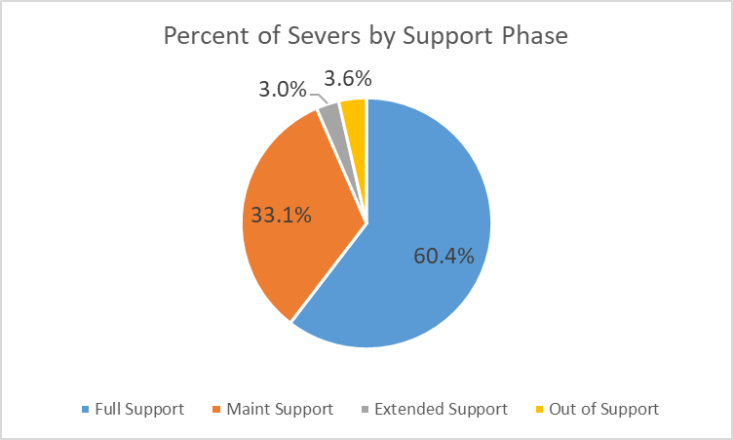
Population of Servers by OEM OS Support Phase
93.5%
of COV servers operating systems are fully supported as provided by the OEM (Microsoft/RHEL/Oracle Linux).
Full Security Support
Enhancements
Enhanced Support

Slide 13
Questions?

Slide 14
Virginian Identity (VID)
Partner persona
Franklin Thurston
Aug. 6, 2025

Slide 15
SPLM process to extend VID to the partner persona
VID current state:
  Provides a single sign-on (SSO) service for COV applications
  Based on the Okta Customer Identity and Access Management (CIAM) SSO solution that has been implemented in a FedRAMP High tenant
  Applications eligible to join the VID SSO service serve the public user persona
  Working through the SPLM process to extend VID to the partner persona
Increased scope with the partner persona:
  Applications eligible to join the VID SSO service serve the public user and partner persona
  Adding additional multi-factor authenticators (MFA) for business partners

Slide 16
Current scenario for the enterprise
Agency silos force citizens to navigate multiple login systems, repeatedly provide the same sensitive information, and manage separate accounts and credentials for different services causing identity sprawl
Legacy systems that are incapable of supporting secure, rapid information sharing within and across agencies impose additional burdens on applicants
Weak password systems create security gaps inviting breaches and fraud
Legacy systems, especially those with outdated identity controls leave agencies increasingly vulnerable

Slide 17
Agency challenges
Budget: Escalating cybersecurity threats and demand for better digital experiences create mounting budget pressures
Agency IT executives often must prioritize core functions like the mounting costs to maintain legacy systems over much needed upgrades and innovation
It is estimated that some agencies spend up to 80% of their budgets to maintain outdated systems that don’t meet today’s needs and demands
Skills gap: As experience staff reach retirement or leave, legacy knowledge leaves the agency creating the burden of maintaining legacy systems with diminishing expertise

Slide 18
Benefits of Virginian Identity
Unification of citizen access and identity governance through centralized management
Secure frictionless authentication across digital services
Strengthens security controls
Adaptive MFA based on risk level
Automated compliance monitoring and reporting
Eliminates silos and automates access management across systems
Improved citizen experience through one SSO
Built-in controls and automated enforcement streamline compliance
Cost savings for agencies and enterprise

Slide 19
Pertinent VID links
VID service catalog request form
VID FAQs
VID overview and benefits​
VID cost structure
VID billing training video
VID glossary
Identity access management – separation of tenants

Slide 20
Questions?
vi_help@vita.virginia.gov

Slide 21
Securing the Transition: Navigating Risk During a Gubernatorial Shift
Michael Watson – Chief Information Security Officer of the Commonwealth, VITA Deputy CIO
August 6, 2025

Slide 22

How Risk Posture Changes During a Transition
• Leadership turnover delays decisions and approvals
• Cybersecurity policies and strategies face reevaluation
• Insider threats increase during staff and leadership transitions
• External threat actors exploit periods of political change
• IT and security budgets may be paused or reassessed

Slide 23

How ISOs Can Account for Elevated Risk
• Reassess agency-specific cyber risks and reprioritize controls
• Revalidate access controls, especially privileged users
• Update incident response plans and leadership contact lists
• Proactively brief new leadership on security posture
• Monitor for targeted threats (e.g., phishing, impersonation)
• Track any new executive orders or legislation

Slide 24

Practical Tools for ISO Transition Management
• Transition Cyber Risk Assessment Checklist
• Access Audit Tracker & Offboarding Logs
• IR Plan Contact Update Forms
• Leadership Cybersecurity Brief Template
• Threat Intelligence Alerts & SOC Monitoring

Slide 25
Summary of Key Risks and ISO Responses
• Leadership Turnover → Update command and communication lines
• Insider Threat → Tighten access and offboarding procedures
• Policy Uncertainty → Continue compliance and advocate continuity
• External Threats → Watch for phishing, impersonation, deepfakes
• Budget Delays → Communicate funding risk impacts to new execs

Slide 26
Questions?

Slide 27

Securing the Future of Mobility: Cybersecurity Challenges and Research at the Center for Transportation Research
Kevin Heaslip
Director, Center for Transportation Research

Slide 28
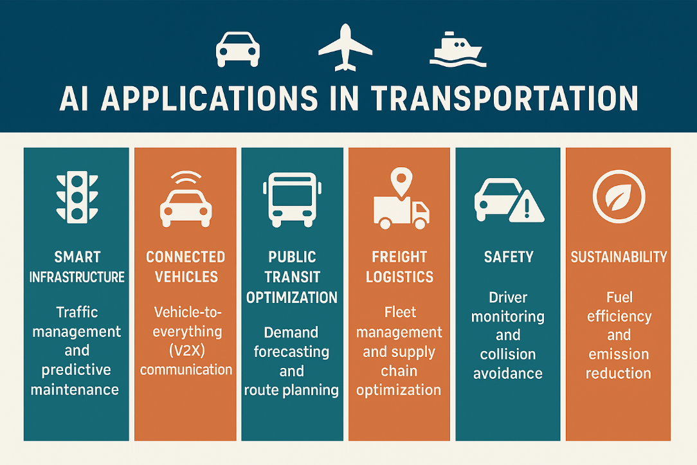
AI Applications in Transportation

Slide 29
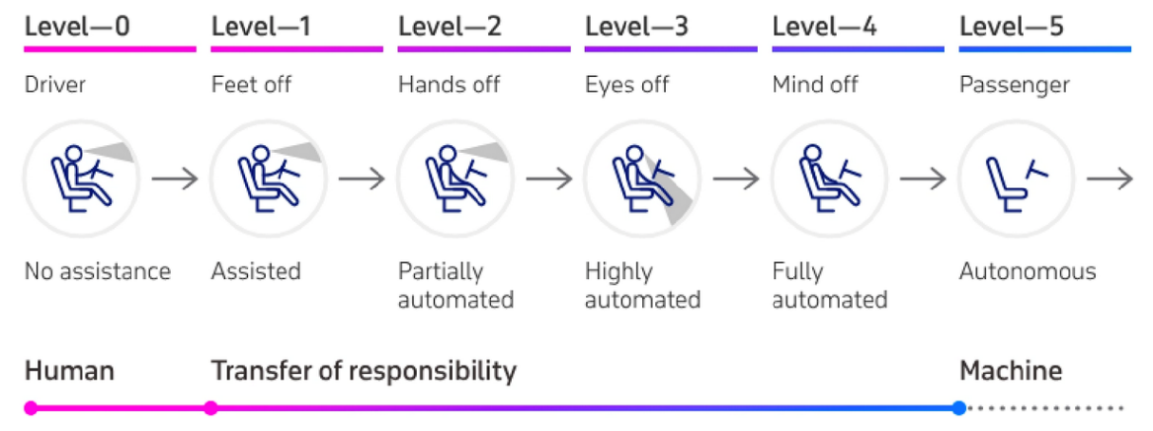
Levels of Automation in Vehicles
Source: Appinventiv

Slide 30
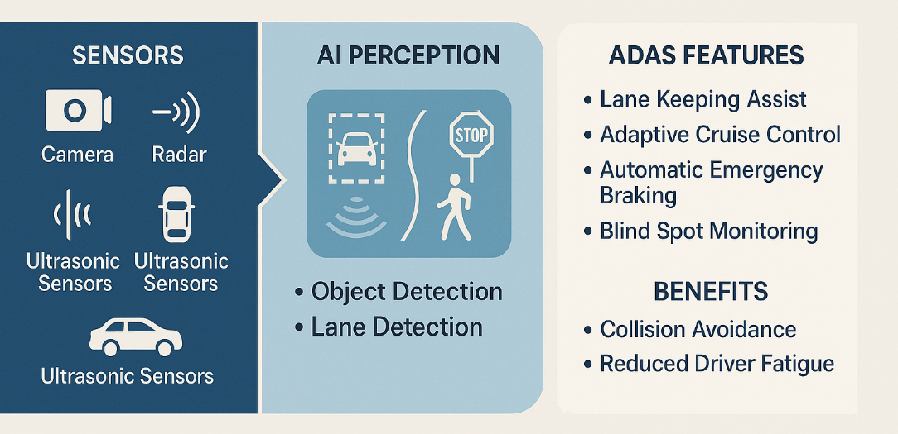
How AI Enhances Advanced Driver-Assistance Systems

Slide 31
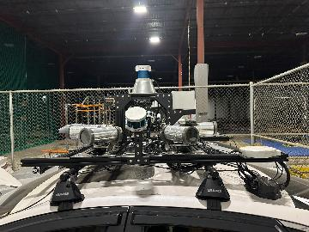
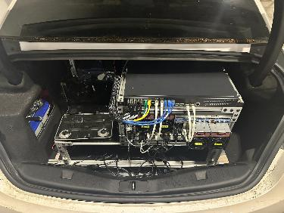
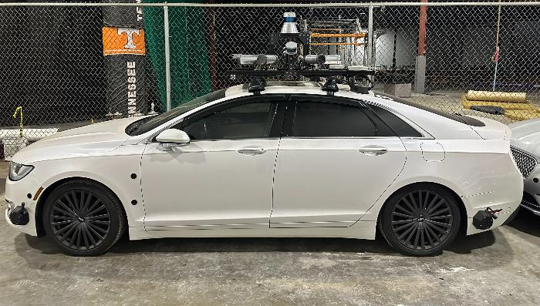
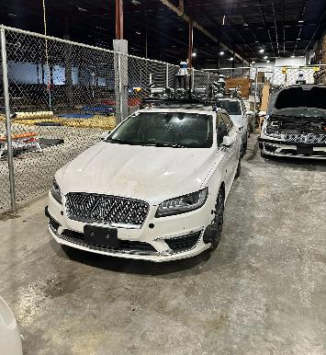
Our research
vehicles

Slide 32
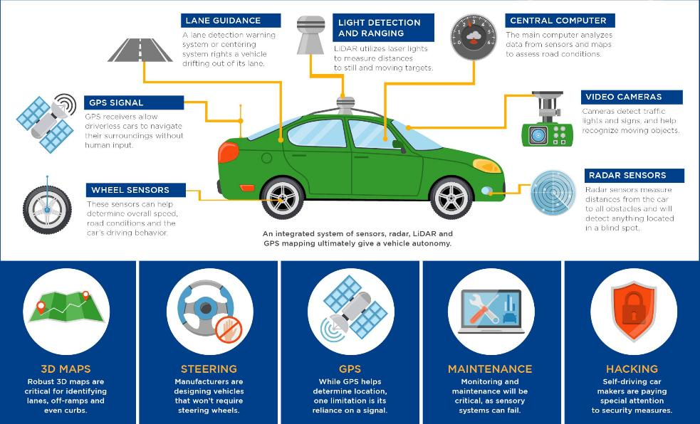
Driverless Vehicle Components

Slide 33
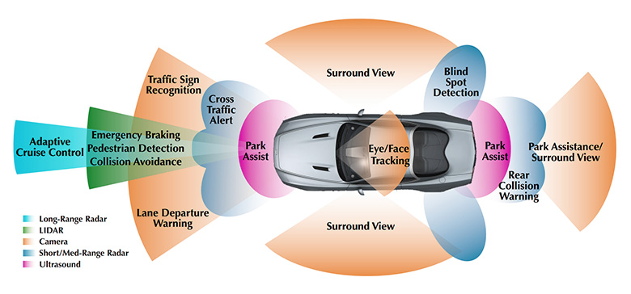
How vehicles sense the world
Source: Ecotron

Slide 34
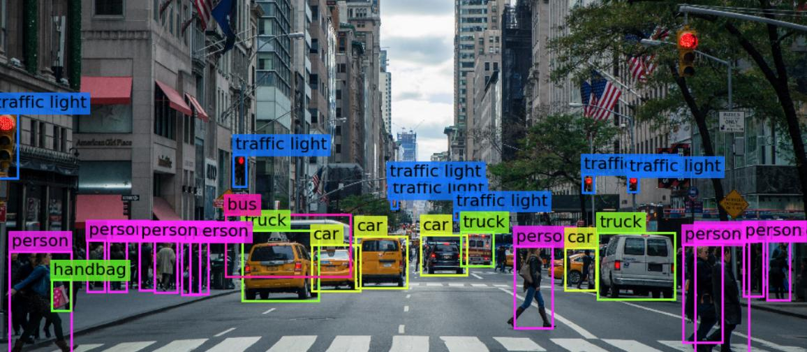
Machine Vision
Source: Medium.com / Safwan Khan

Slide 35

LiDAR Real Time Mapping
Source: GPS World

Slide 36
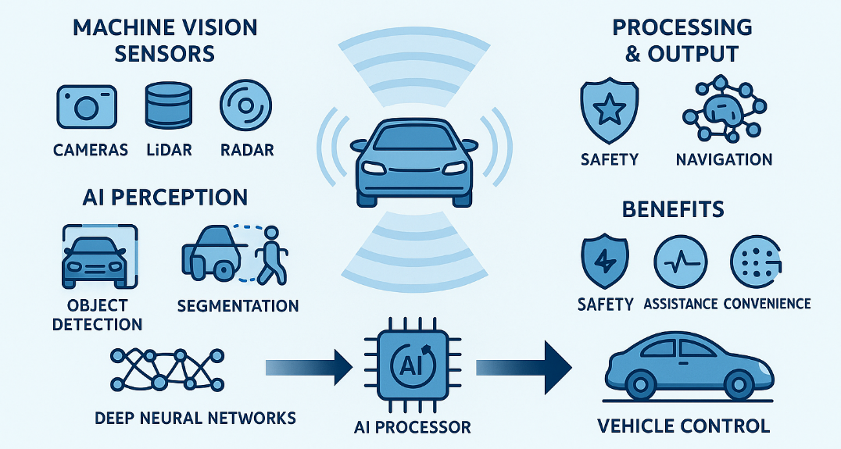
Machine Vision and AI for Vehicles

Slide 37
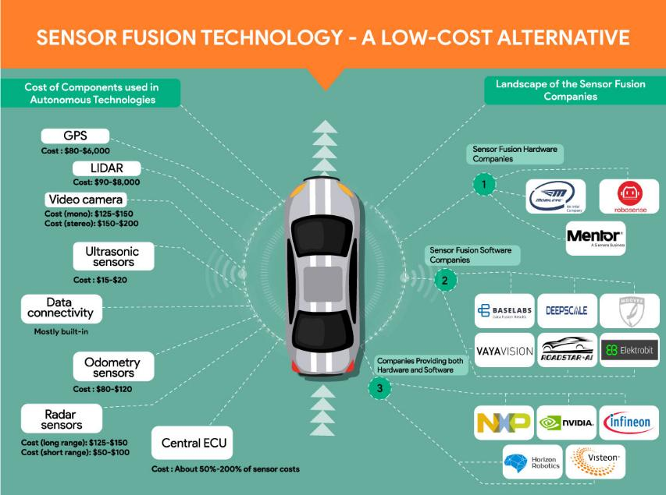
Sensor Fusion Technology – a low-cost alternative
Source: IdeaPoke AI

Slide 38
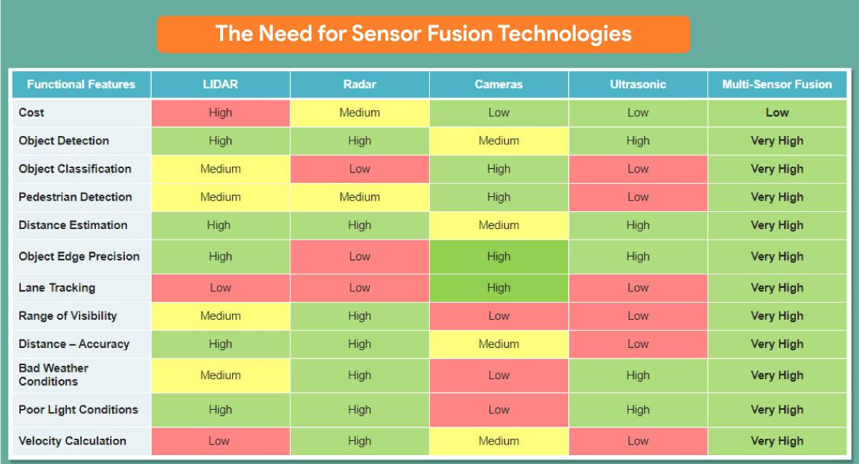
The Need for Sensor Fusion Technologies
Source: IdeaPoke AI

Slide 39







Cybersecurity
Protecting automotive electronic systems, communication networks, control algorithms, software, users, and underlying data from malicious attacks, damage, unauthorized access, or manipulation
Protect everything from a car's infotainment system to its wiring to the communication networks that run between its software and hardware
AI-powered data processors and chips
Electrical system engineering services for IoT hardware, software, devices, and vehicles
Cyber-physical systems (CPS)
Hardware security modules
NHTSA, Automotive Cybersecurity

Slide 40
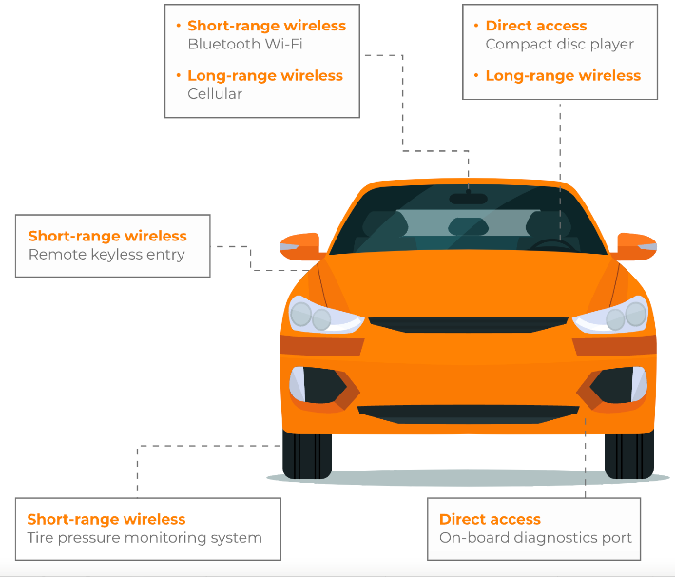
Vehicle Attack Surfaces

Slide 41
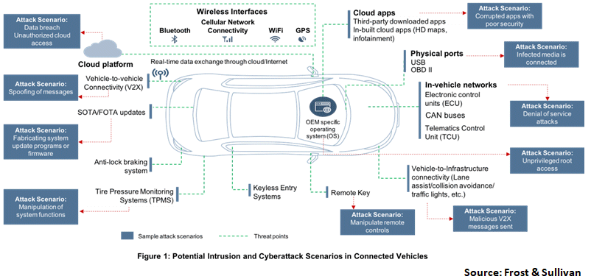
Connected Vehicle Attacks

Slide 42

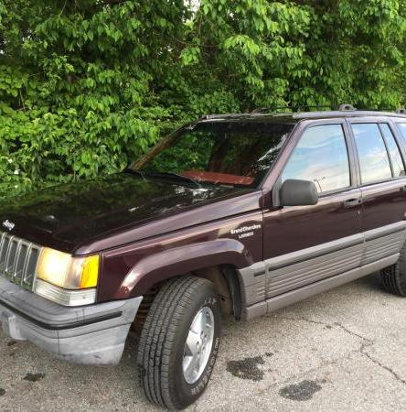
Real-World Examples of Cyber Threats in Transportation
Jeep Cherokee Hack Incident
In 2015, researchers exploited vulnerabilities in the Jeep Cherokee's infotainment system, gaining remote control over critical vehicle functions, which led to a recall of over a million vehicles by Fiat Chrysler Automobiles to address these security flaws.

Slide 43

Real-World Examples of Cyber Attacks Affecting Vehicles
Hackers infiltrated a Tesla Model S, showcasing risks in wireless connectivity and prompting immediate software updates.
Significant vulnerabilities in China's connected vehicle networks affected over 220,000 vehicles, risking data manipulation.
Ongoing research continues to reveal new vulnerabilities in vehicle-to-everything (V2X) communications, threatening road safety.
2015
2020
2022
1
2
3
4
5
6
The Jeep Cherokee hack demonstrated remote control vulnerabilities, leading to a major recall of 1.4 million vehicles.
2016
Honda faced a ransomware attack that disrupted operations, highlighting potential vulnerabilities in connected vehicle systems.
2021
A data breach at Kia Motors and Hyundai raised concerns about the security of onboard systems linked to customer databases.
2023

Slide 44


Current Cybersecurity Measures in Vehicles
Proactive Threat Detection
Advanced Intrusion Detection Systems (IDS) utilize machine learning algorithms to analyze network traffic patterns, enabling real-time identification of potential threats and minimizing response times to cyber incidents.
Dynamic Firewall Adaptation
Modern firewalls in vehicles are equipped with adaptive capabilities that allow them to update security rules automatically in response to emerging threats, ensuring continuous protection against unauthorized access.
Regular Software Maintenance
Over-the-Air (OTA) updates not only enhance security but also improve vehicle functionality by providing manufacturers with the ability to deploy timely patches and feature enhancements, thereby maintaining optimal performance and safety.

Slide 45

Authentication and Encryption
Importance of Robust Protocols
Implement robust authentication protocols to confirm the identity of all parties involved in V2X communication.
Apply strong encryption methods to protect data in transit between vehicles and infrastructure.
Maintain data integrity and confidentiality to ensure messages cannot be tampered with or intercepted.
Prevent unauthorized access and cyber threats that could disrupt V2X systems and jeopardize roadway safety.

Slide 46

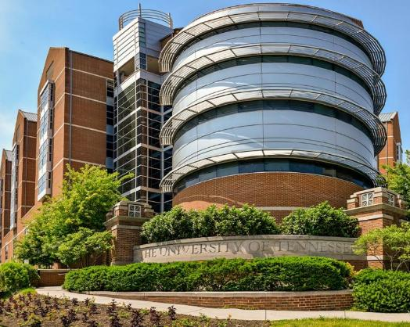
Center for Transportation Research
1
CTR has been a nationally and internationally recognized research center at the University of Tennessee since 1972
2
CTR has over $13 million in programs under contract
3
CTR supports UT’s responsibility to supply well-educated transportation students to the growing field of transportation professionals
4
CTR strives to address transportation research, education, and technology transfer needs for the nation, our region, and our community
Notes:
Image source: https://tickle.utk.edu/bridging-the-gap-project-aims-to-increase-transportation-equity/

Slide 47
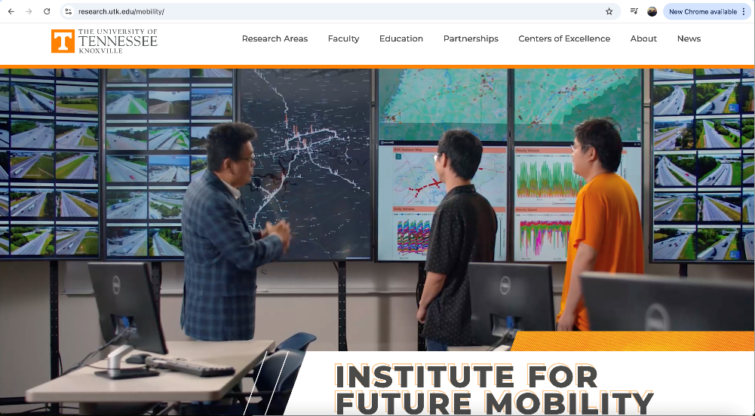
Institute for Future Mobility

Slide 48
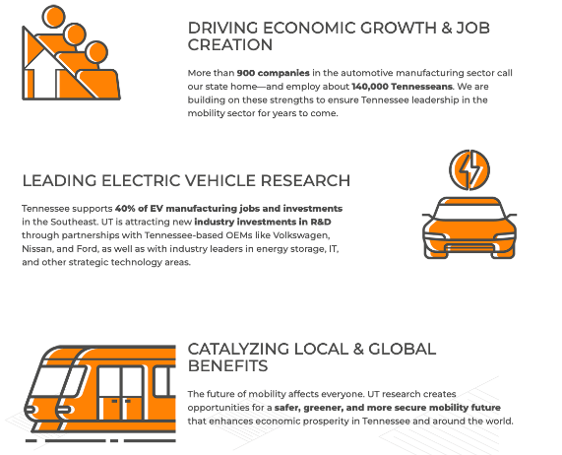
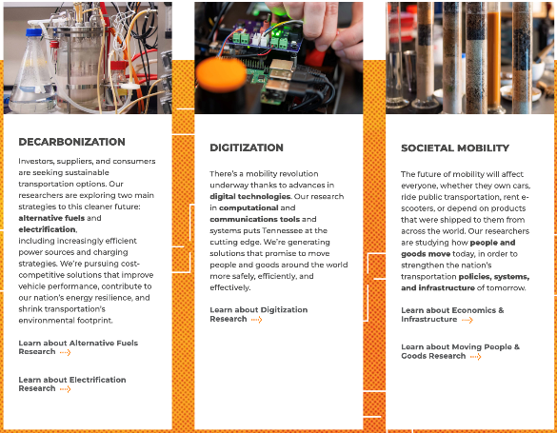
Future Mobility Research
Importance of Robust Protocols
Effective authentication and encryption protocols are essential for safeguarding V2X communication, as they ensure the integrity and confidentiality of data exchanged between vehicles and infrastructure, thereby preventing unauthorized access and potential cyber threats that could compromise roadway safety.

Slide 49
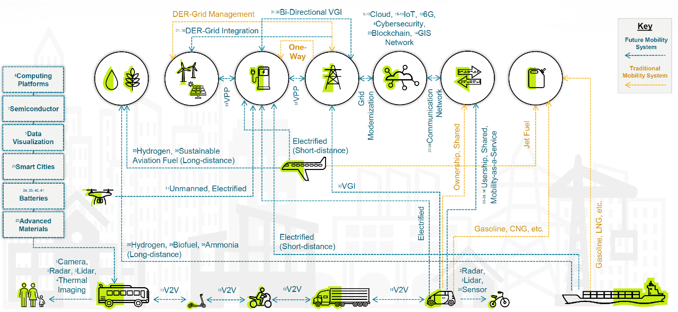
Research Landscape

Slide 50
Any Questions?
Contact information:
Kevin Heaslip
kheaslip@utk.edu
865-974-1813

Slide 51

Announcements
ISOAG August 6, 2025
Notes:
Example of when to use this slide background for a call out section and text

Slide 52
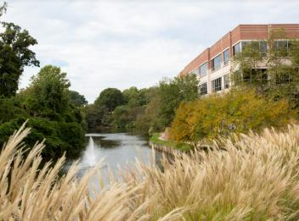
VITA - CSRM Governance Welcomes two analysts!
We would like to extend a warm welcome to our new governance analysts: Kaffy Iyanda and Jelani Lynch

Slide 53

International Travel
As traveling season approaches us, lets make sure we all understand how to comply with COV guidelines regarding devices.
Before your trip, be sure to check out the knowledge base article on the VCCC site if you are travelling internationally.
If you’re unsure about any compliance requirements, don’t hesitate to ask!

Slide 54

SPLUNK UPDATE August 2025
WE WANT YOUR LOGS: VITA is working with agencies to ingest their application logs in to the VITA Splunk instance. We ask that all agencies start identifying what logs you would like to have ingested. We are always happy to schedule a call to review your options.
Notes:
Example of when to use this slide background for a call out section and text

Slide 55


Top 5 Vulnerabilities
For the month of August, the Top 5 Key Vulnerabilities are:
  Apache Log4j SEoL < 1.x
  Apache Log4j 1.x Multiple Vulnerabilities
  Mozilla Foundation Unsupported Application Detection (Firefox)
  MS10-031: Vulnerability in Microsoft Visual Basic for Applications (978213)
  IBM WebSphere Application Server (6258333)
*NOTE* Check CSRM Connections for more detailed information
vita.virginia.gov
Notes:
This slide background works best with text heavy sections, with no imagery OR when an Icon is used

Slide 56

Acunetix Survey
Survey Name: Acunetix 360 Customer Satisfaction Survey
Survey Link: https://forms.office.com/g/K8PbAKrcC5
Available From: August 7, 2025 through August 22, 2025
Why should ISOs do it? It’ll help us spot any gaps and see how the product is performing, so we can make it even better.
vita.virginia.gov
Notes:
This slide background works best with text heavy sections, with no imagery OR when an Icon is used

Slide 57
Upcoming Events
vita.virginia.gov
Notes:
This slide is used as a transition title slide for a new section

Slide 58

Governance Office Hours Announcement
Governance Office Hours launch recently – a dedicated space for Agency ISOs and teams to bring their questions, concerns, or ideas directly to the Governance Team.
What to Expect:
Open discussion place
Governance Updates
Q&A and support for your needs
Next Session:
August 13th, 2025 | Microsoft Teams
[Click here to join the meeting]
Let’s work together to strengthen governance across the Commonwealth!
Notes:
Example of when to use this slide background for a call out section and text

Slide 59

Commonwealth of Virginia Information Security Conference 2025
ISC:25
Future-Proofing Cybersecurity: Next-Gen Strategies
August 14, 2025
Earn 5 CPE credits!
(Registrations after this date will
require a handwritten badge)
Security Conference | Virginia IT Agency
Registration page
Notes:
This slide works best with photos and graphs/charts. Image and text can be reversed

Slide 60

COVITS
To register

Slide 61

Service Tower SOC Report Review Sessions
      To register for this meeting, please click on the link below: https://covaconf.webex.com/weblink/register/r356265cb4b5d84cfa98903fb0adb74f2
The upcoming SOC review session is September 18, 2025, and will be held remotely.
Please register at the link below
Notes:
Example of when to use this slide background for a call out section and text

Slide 62

IS Orientation
The next IS Orientation is being held on September 24, 2025
  September 24, from 9am to 4pm, registration closes Sept 17th.
  It will be held in-person at the Boulders location:
  7325 Beaufont Springs Drive, Richmond, VA 23225
  Visit Commonwealth IS Orientation to register!
Notes:
This slide works best with photos and graphs/charts. Image and text can be reversed

Slide 63

The October 1, 2025 ISOAG Meeting will be In-Person
(and virtual)
Location: Reynolds Community College
Time: 1-4 pm
Please remember that in-person attendance is mandatory for primary, in-scope ISOs to maintain credentials. If one is unable to attend, you must let CSRM know and email who the designated person to come in that place is by September 17.

Slide 64
MEETING ADJOURNED
Notes:
Title slide - Any text that looks black is HEX code 414042. If you have an idea for an image, let me know and I can provide you with one.

